Slide 1
Choosing Innovation Projects

Slide 2
The question posed
New product development is inherently risky and expensive, putting pressure on managers to make careful choices among projects
Firms use a mix of formal, informal, quantitative and qualitative methods when selecting and managing innovation projects and each of these methods has its own strengths and weaknesses.
Often the choices are driven by strategic implications rather than strictly financial analysis

Slide 3
The Development Budget
Most firms face serious constraints in capital and other resources they can invest in projects.
Many firms use capital rationing (a fixed R&D budget and project rankings) to choose between valuable projects.
Firms might establish this budget based on industry benchmarks, historical performance benchmarks and/or on a desired level of R&D intensity.
→Expenditures on R&D vary widely between industries and between firms in the same industry.

Slide 4
The Development Budget
R&D Intensity varies considerably across and within industries.
Rank | Three Dig. SIC Code | Industry Description | Number of Publicly-Held Firms | Industry R&D Spend ($millions) | Industry Revenues ($millions) | Industry R&D Intensity (R&D/Sales)
1 | 2830 | Drugs, biological products, and diagnostics | 782 | $137,560 | $704,234 | 0.20
2 | 3550 | Special industry machinery | 38 | $4,504 | $35,711 | 0.13
3 | 3670 | Semiconductors and electronic components | 191 | $48,136 | $439,169 | 0.11
4 | 7370 | Software and computer programming services | 633 | $89,310 | $871,904 | 0.10
5 | 3840 | Medical equipment | 211 | $12,046 | $151,316 | 0.08
6 | 3660 | Communication equipment | 79 | $22,624 | $306,619 | 0.07
7 | 3820 | Measuring equipment and instruments | 83 | $7,996 | $109,967 | 0.07
8 | 3570 | Computers and peripherals | 81 | $25,580 | $354,589 | 0.07
9 | 5960 | Nonstore retailers | 41 | $16,120 | $245,297 | 0.07
10 | 3710 | Motor vehicles and motor vehicle equipment | 82 | $70,509 | $1,691,357 | 0.04

Slide 5
The Development Budget (Top 10, 2016): impact of firm size on R&D budgets
Company | Sales ($millions) | R&D ($millions) | R&D intensity (R&D/Sales)
AMAZON.COM | $135,987 | $16,085 | 12%
ALPHABET | $90,272 | $13,948 | 15%
INTEL | $59,387 | $12,740 | 21%
VOLKSWAGEN | $231,205 | $12,144 | 5%
MICROSOFT | $85,320 | $11,988 | 14%
ROCHE HOLDING | $51,807 | $11,350 | 22%
MERCK & CO | $39,807 | $10,124 | 25%
APPLE | $215,091 | $10,045 | 5%
TOYOTA MOTOR | $252,652 | $9390 | 4%
JOHNSON & JOHNSON | $71,890 | $9124 | 13%
NOVARTIS | $48,518 | $9039 | 19%
PFIZER | $52,824 | $8375 | 16%
GENERAL MOTORS | $166,380 | $8100 | 5%
FORD MOTOR | $151,800 | $7300 | 5%
CISCO SYSTEMS | $49,247 | $6296 | 13%
FACEBOOK | $27,638 | $5919 | 21%
ASTRAZENECA | $23,408 | $5890 | 25%
HONDA MOTOR CO | $129,880 | $5840 | 4%
ORACLE | $37,047 | $5787 | 16%
IBM | $79,920 | $5751 | 7%
Source: Data from Compustat.

Slide 6
Financing New Technology Ventures
Large firms can fund innovation internally.
New ventures often have to rely on external financing, family, friends, and/or personal debt because technology start-ups often have an unproven technology, an unproven business concept and/or an unproven management team.

Slide 7
Sources of financing
Three additional sources of financing are:
(1) Government grants and loans from agencies such as the Small Business Administration in the U.S. or the Enterprise fund in the UK.
If idea and management are especially promising, entrepreneur may secure funds from (2) “angel investors” (typically for projects <1 million) or (3) venture capitalists (for projects >1 million).

Slide 8
Quantitative Methods for Choosing Projects
Commonly used quantitative methods include discounted cash flow methods and real options.
They have pros and cons, strengths and weaknesses.
→ Many factors in the choice of development projects are extremely difficult (or misleading) to quantify.
→ Therefore almost all firms use some qualitative methods.
Access the text alternative for these images

Slide 9
Qualitative Methods of Choosing Projects
Screening Questions are organized into categories and are used by managers to structure technology project investment discussions.
If managers want to formalize the process they can utilize a scoring mechanism (i.e. scaled responses to each question like “Project fits closely with existing competencies” to “Project fits poorly with existing competencies”) that can then be weighted according to importance. Sample screening questions follow (a more extensive list can be found in the text):

Slide 10
Screening Questions include:
Role of customer (market, use, compatibility and ease of use, distribution and pricing) with questIons like:
How big is the market of likely customers and what types of marketing will reach them best?
How will the customer value the product relative to substitutes?
How will the customer perceive the ease-of-use of the product (e.g. complements, training, etc.)?
How will the product be distributed?

Slide 11
Screening Questions include:
Role of capabilities (existing capabilities, competitors’ capabilities, future capabilities) with questions like:
What affect will the new project have on current core competencies (e.g. leverage, obsolete)?
Will the firm be able to handle the possible cash flow implications?
What new competencies will the firm have to develop and will these new competencies help the firm achieve its strategic intent?

Slide 12
Screening Questions include:
Project Timing and Cost with questions like
Does the firm have a choice with regard to entry timing (i.e. does the firm have the capabilities to be a first mover)?
How variable are the projected costs and learning curve effects?

Slide 13
The Aggregate Project Planning Framework
The Aggregate Project Planning Framework focuses a firm’s attention on the mix of development projects in its R&D portfolio in order to determine whether the projects are consistent with the company’s resources and strategic intent.
The framework also enables firms to determine whether its portfolio is balanced between projects with short and long-term payoff horizons.
To create the map managers categorize their existing projects according to the resources required and the parts of the company’s product line they support.

Slide 14

The Aggregate Project Planning Framework
Four types of development projects appear in the map:
1. Advanced R&D projects
2. Breakthrough projects
3. Platform projects
4. Derivative projects

Slide 15
1. Advanced R&D projects
Advanced R&D projects are necessary to the development of cutting edge strategic technologies (e.g. Honda’s work on hydrogen fuel cells).
If firm’s portfolio consists entirely of advanced R&D projects the firm may not be able to sustain itself in the short term (i.e. no short term cash flows).
There may be no obvious immediate commercial application.

Slide 16
2. Breakthrough projects
Breakthrough projects incorporate revolutionary new product and process design technologies into a new product -- that is they are oriented around a specific commercial application (e.g. Honda’s development of Insight).

Slide 17
3. Platform projects
Platform projects generate fundamental improvements in the cost, quality, and performance of a technology versus prior generations and are designed to serve a core group of customers (e.g. Hunter’s “Care Free humidifier)

Slide 18
4. Derivative projects
Derivative projects involve incremental changes in products and/or processes (Like Toyota’s Camry).
If a firm’s portfolio includes only derivative projects then it may have good short-term returns but also may not be able to compete when the market moves to a new technology.

Slide 19
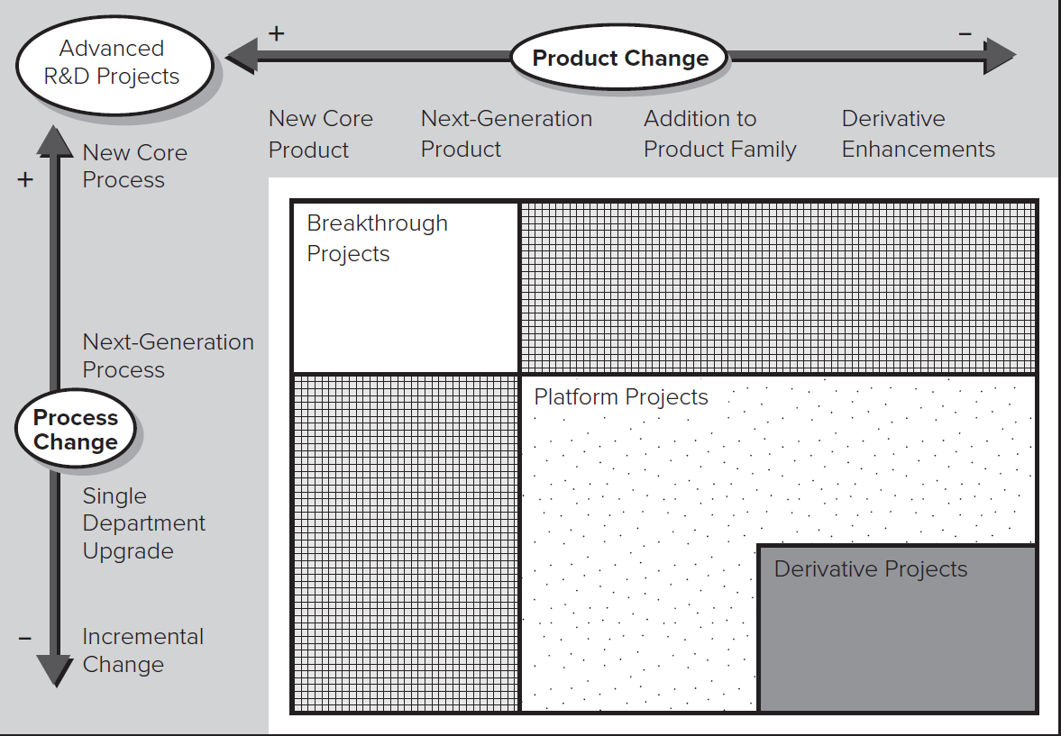
The Aggregate Project Planning Framework.
Source: Steven C. Wheelwright and Kim B. Clark from Revolutionizing Product Development: Quantum Leaps in Speed, Efficiency, and Quality.
Access the text alternative for these images

Slide 20
The Aggregate Project Planning Framework.
A recent research has shown that in the firms that participated in the survey
8% of their projects were advanced R&D or breakthrough
17% were platform projects
75% were derivative projects

Slide 21
«You cannot grow long term if you cannot eat short term»
(Jack Welch, former CEO of General Electric)

Slide 22
Qualitative Methods of Choosing Projects
Advanced R&D Projects: develop cutting-edge technologies; often no immediate commercial application.
Breakthrough Projects: incorporate revolutionary new technologies into a commercial application.
Platform Projects: not revolutionary but offer fundamental improvements over preceding generations of products.
Derivative Projects: incremental improvements and variety in design features.
Derivative projects pay off the quickest and help service the firm’s short-term cash flow needs. Advanced R&D projects take a long time to pay off (or may not pay off at all) but can position the firm to be a technological leader.
Managers then compare actual balance of projects with desired balance of projects.

Slide 23
Qualitative Methods of Choosing Projects: Q-Sort
Q-Sort is a simple method for ranking ideas on different dimensions.
Individuals are given a stack of cards (on each card is a development project) they put in order according to their assessment of how well each project performs on the criteria presented (e.g. technical feasibility, market impact, fit with strategic intent).
These rankings are then used to structure a debate about the projects.

Slide 24
Combining Quantitative and Qualitative Information : Conjoint Analysis
Managers may use multiple methods in combination.
May also use methods that convert qualitative information into quantitative form (though this has similar risks as quantitative methods).
Conjoint Analysis estimates the relative value individuals place on attributes of a choice.
Individuals given a card with products (or projects) with different features and prices.
Individuals rate each in terms of desirability or rank them.
Multiple regression then used to assess the degree to which an attribute influences rating. These weights quantify the trade-offs involved in providing different features.

Slide 25
Courtyard by Marriot
Marriot used conjoint analysis to help it develop a midprice hotel line.
First used focus groups to identify customer segments and attributes they cared about in a hotel.
Then created potential hotel profiles that varied on these features and asked participants to rate the profiles.
Regression identified which features were valued most.
Based on the results, Marriott developed Courtyard concept: relatively small hotels with limited amenities, small restaurants and meeting rooms, courtyards, high security, and rates of 40-60 a night.

Slide 26
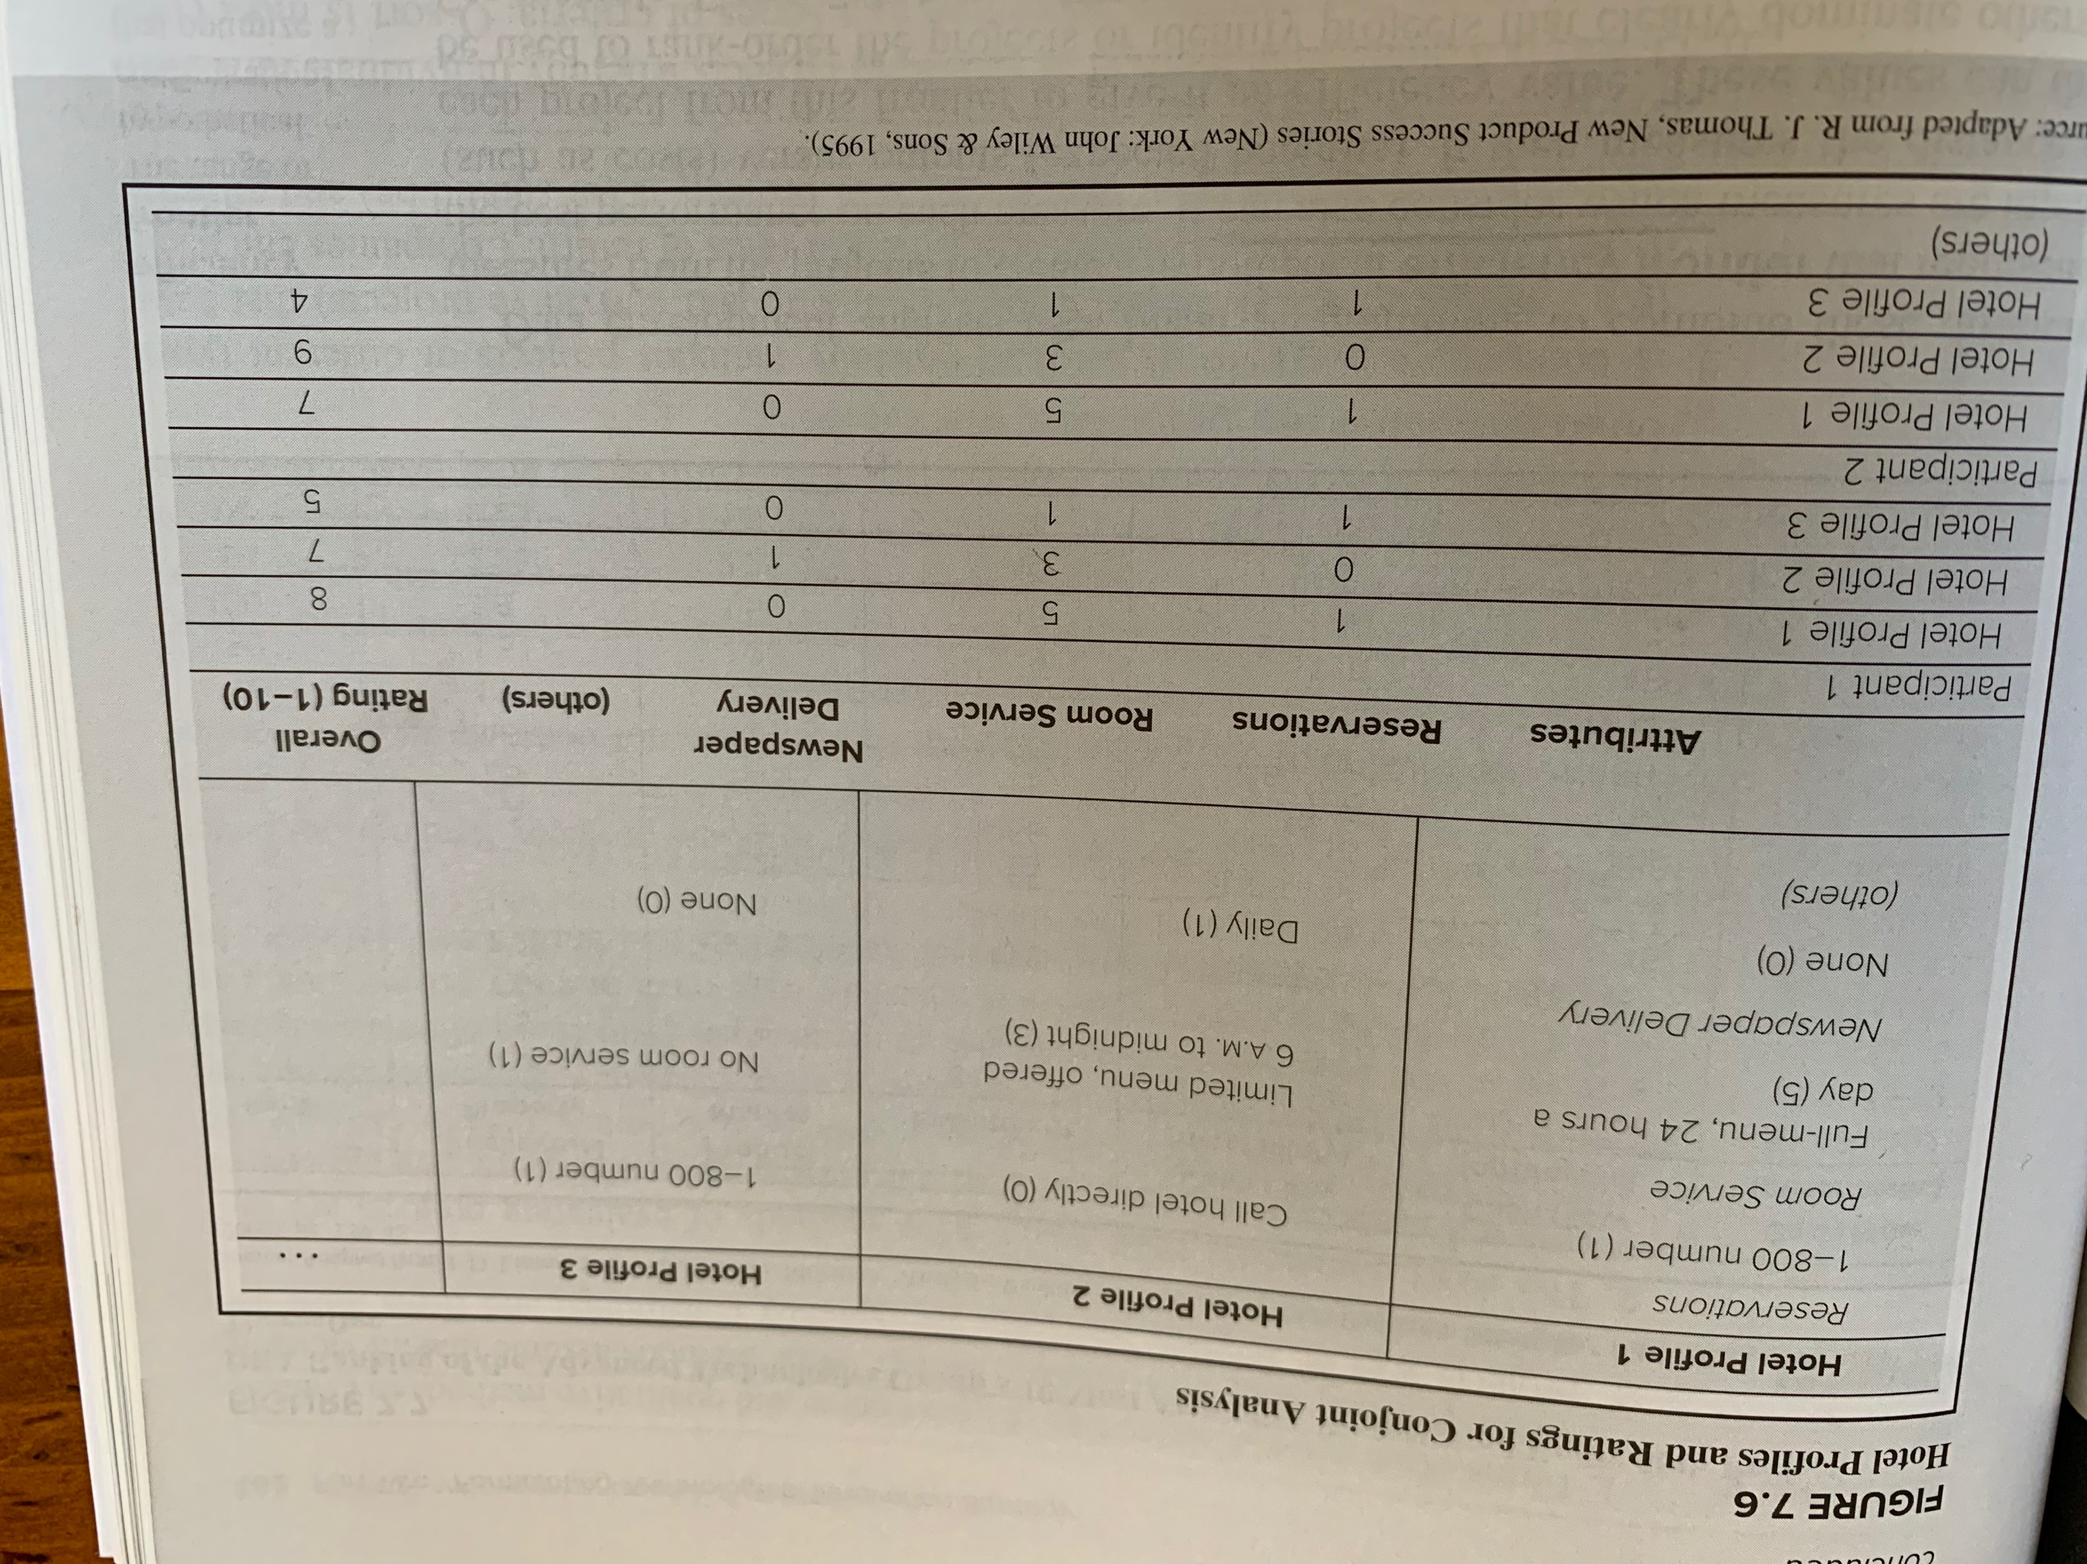

Slide 27
Combining Quantitative and Qualitative Information : DEA
Data Envelopment Analysis (D E A) uses linear programming to combine measures of projects based on different units into a hypothetical efficiency frontier.
Projects can be ranked by assessing their distance from efficiency frontier.
As with other quantitative methods, D E A results only as good as the data utilized; managers must be careful in their choice of measures and their accuracy.

Slide 28
Where Should We Focus Our Innovation Efforts? An Exercise
The technologies that underlie products and services evolve along trajectories, and once we can see the “big picture” of these trajectories, we will know where the next big breakthroughs are likely to be.
Looking back at the path a technology has taken over time (as far back as possible) can help to reveal the high level dimensions that drive technological change.
Identifying the marginal payoff of investing in further improvements in each dimension can help identify where the biggest payoffs are.

Slide 29
Where Should We Focus Our Innovation Efforts? An Exercise
STEP ONE: Identifying the Dimensions.
First try to identify the path the technology has taken over the past:
Were there phases when different aspects changed?
Can you identify the dimensions along which it changed?
Next, try to imagine what customers would want if they could have anything.
Does this suggest dimensions you haven’t considered?

Slide 30
Where Should We Focus Our Innovation Efforts? An Exercise
STEP TWO: Map the Utility Curve for Investing in Each Dimension.
Try to estimate the shape of the customer’s utility curve with respect to each of the dimensions you identified.
Next estimate where you think we are now on each of those curves.
Which dimensions offer the most relative utility to be gained? What is the costliness of moving along those curves? Where would our effort best be deployed?

Slide 31
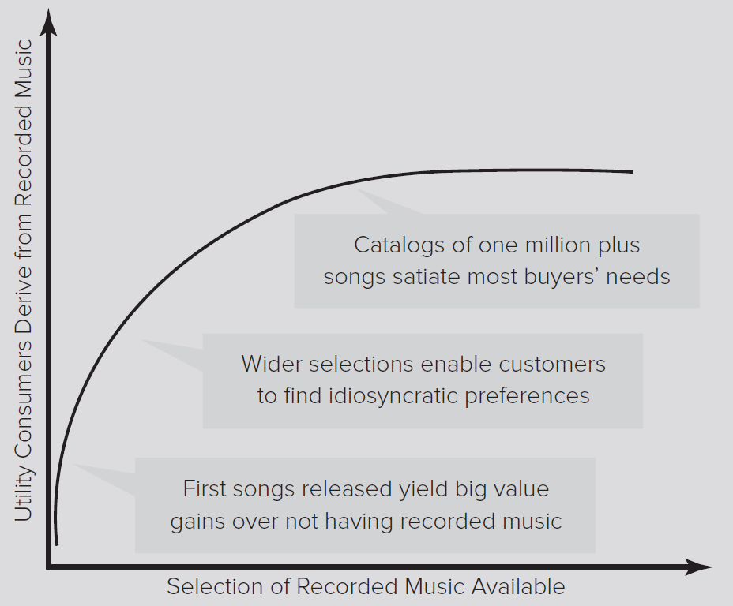
Where Should We Focus Our Innovation Efforts? An Exercise
STEP TWO: Map the Utility Curve for Investing in Each Dimension.
Access the text alternative for these images

Slide 32
Where Should We Focus Our Innovation Efforts? An Exercise
STEP THREE: Determine your Focus.
Rank | Dimension | Importance to Buyers (1–5 scale) | Room for Improvement (1–5 scale) | Ease of Improvement (1–5 scale) | Total Score
 | Cost | 4 | 2 | 2 | 8
 | Comfort | 4 | 4 | 3 | 11
 | Reliability | 5 | 1 | 1 | 7
 | Ease of use | 3 | 2 | 3 | 8

Slide 33
Discussion Questions
What are the advantages and disadvantages of discounted cash flow methods such as NPV and IRR?
For what kind of development projects might a real options approach be appropriate? For what kind of projects would it be inappropriate?
What are some of the reasons that a firm might use both qualitative and quantitative assessments of a project?
Identify a particular development project you are familiar with. What kinds of methods do you believe were used to assess the project? What kinds of methods do you believe should have been used to assess the project?
Will different methods of evaluating a project typically yield the same conclusions about whether to fund its development? Why or why not?

